Slide 1
INFO 5871-001: Data Science / Info Science
Robin burke, Fall 2019

Slide 2
Outline
Introductions
Class organization
Data
Break
Lab

Slide 3
Introduction
Week 1, Part 1

Slide 4
Student information
Please fill out form
10 min

Slide 5
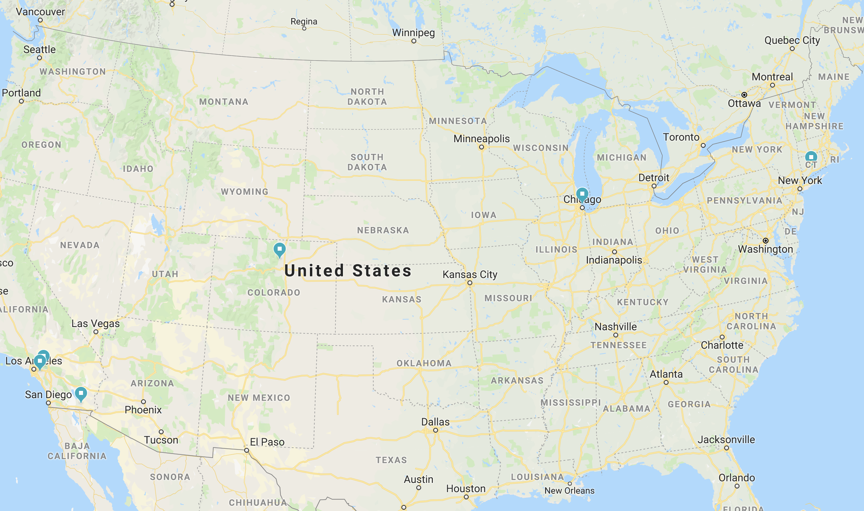
About me
Yale University
Northwestern University
University of Chicago
DePaul University
CU Boulder
Verb, Inc.
University of California, Irvine
Cal State Fullerton
Harvey Mudd College
Holtville, CA

Slide 6
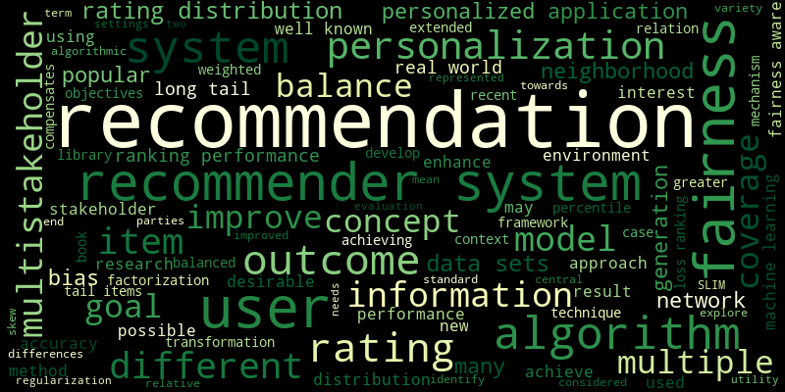

Slide 7
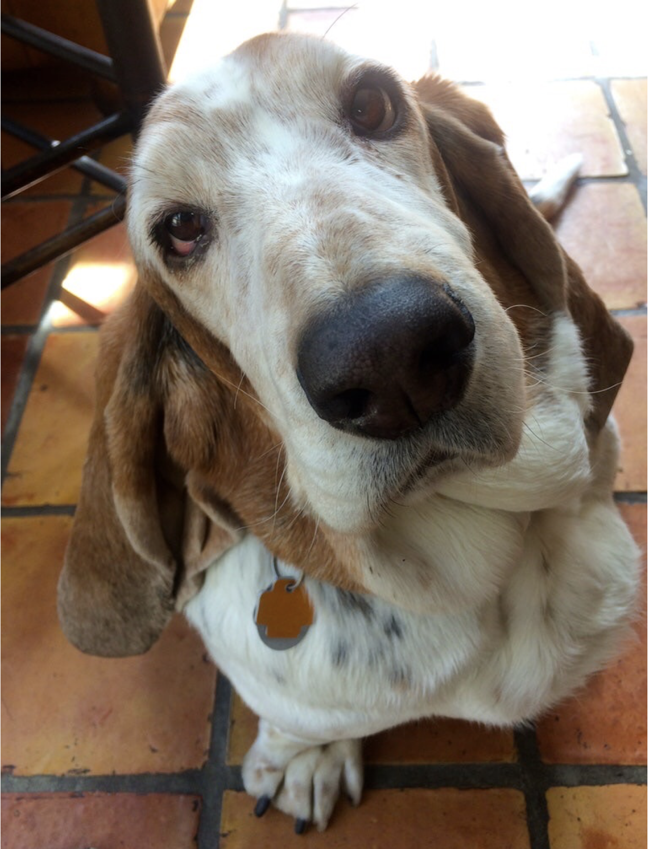
Unique fact

Slide 8
Your Turn
Name
Program, Year, Advisor if PhD
Unique fact

